Slide 1
Python for data science

Slide 2
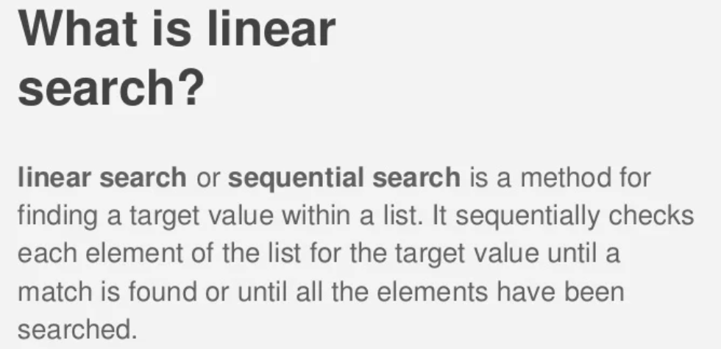

Slide 3
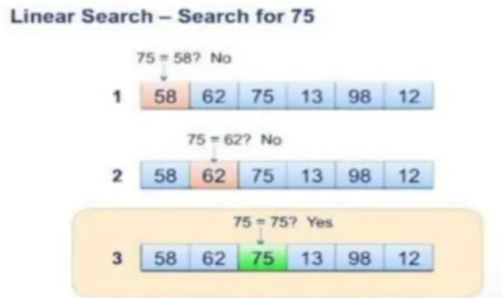

Slide 5
SORTING

Slide 6
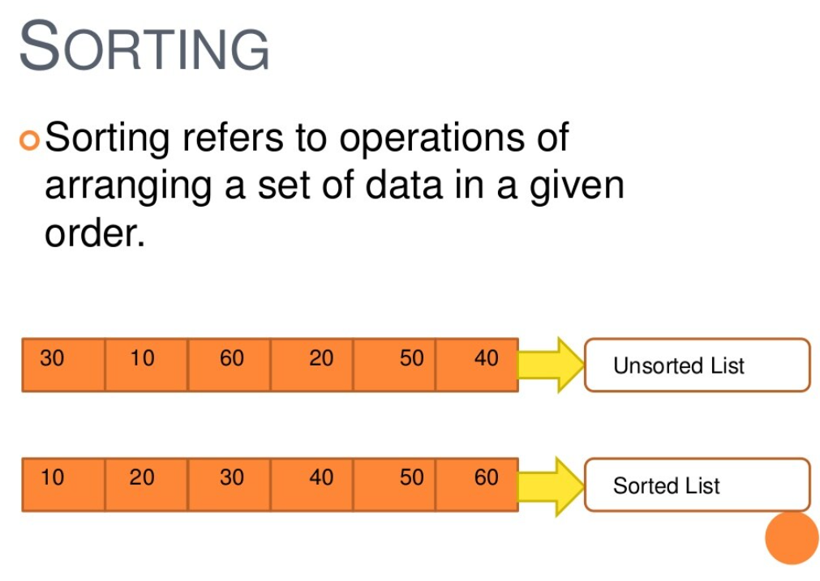

Slide 7
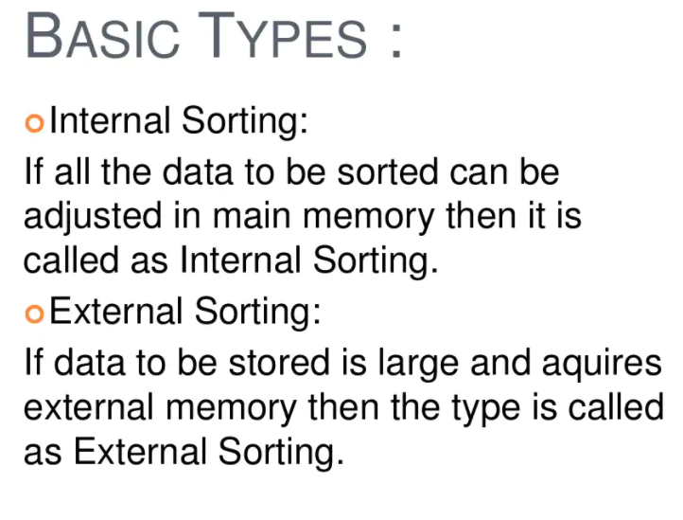

Slide 8
METHODS OF SORTING :
SELECTION SORT
INSERTION SORT
MERGE SORT
QUICK SORT

Slide 9
SELECTION SORTING

Slide 10
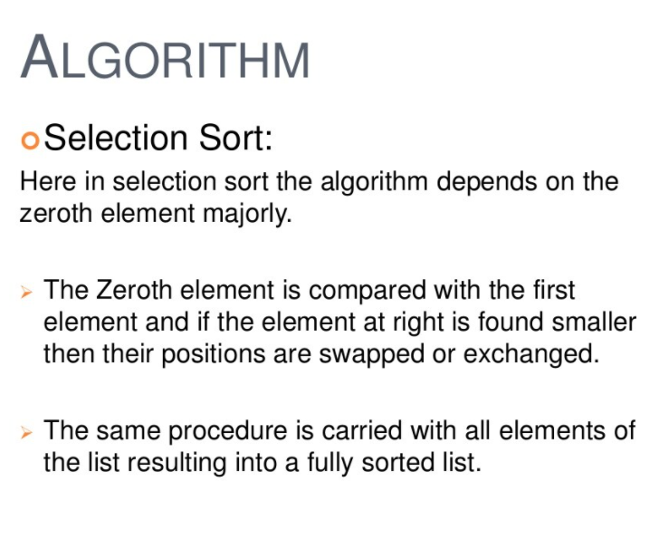

Slide 11
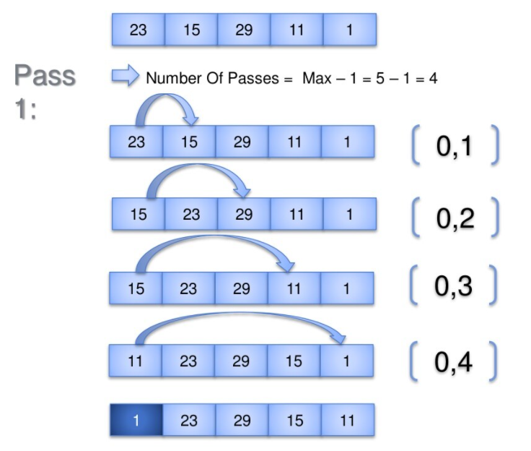

Slide 12
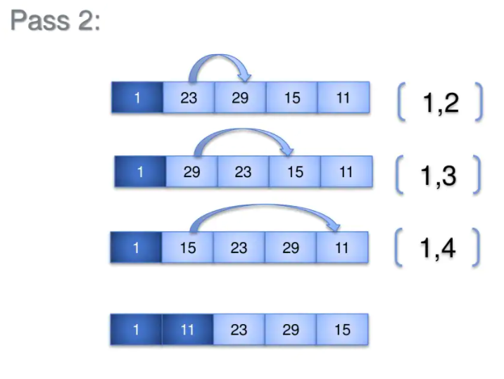

Slide 13
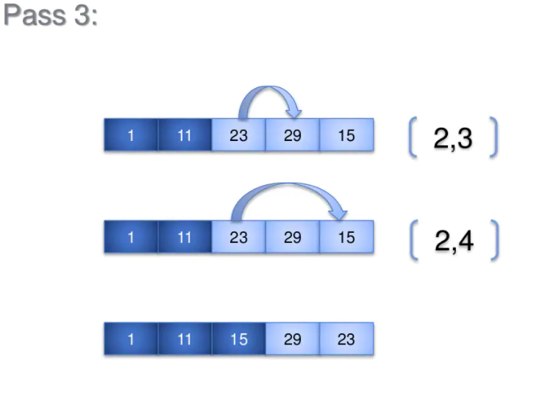

Slide 14
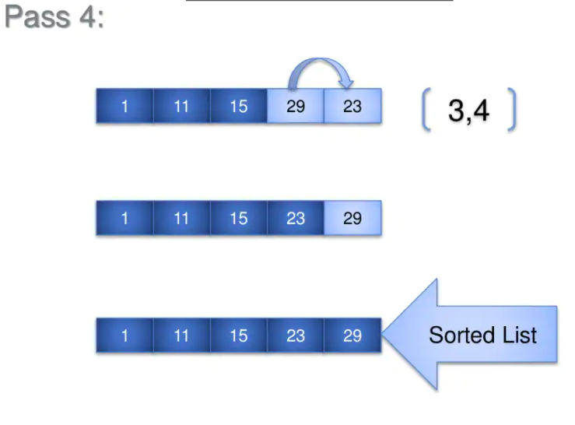

Slide 15
INSERTION SORT

Slide 16
When to use insertion sort ?
This method is effective when dealing with small numbers
Applications using insertion sort :
Mathematical applications : in the search for smaller or greater value and many such applications

Slide 17
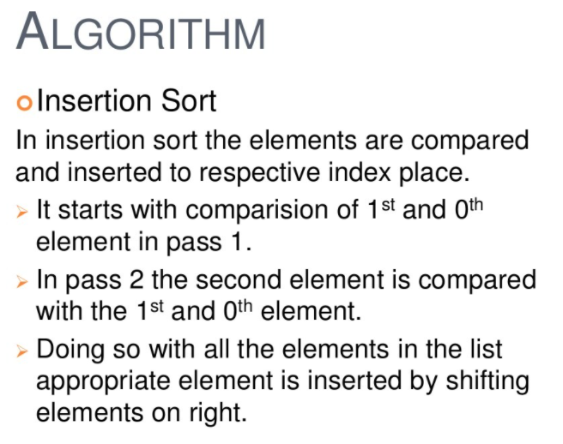

Slide 18
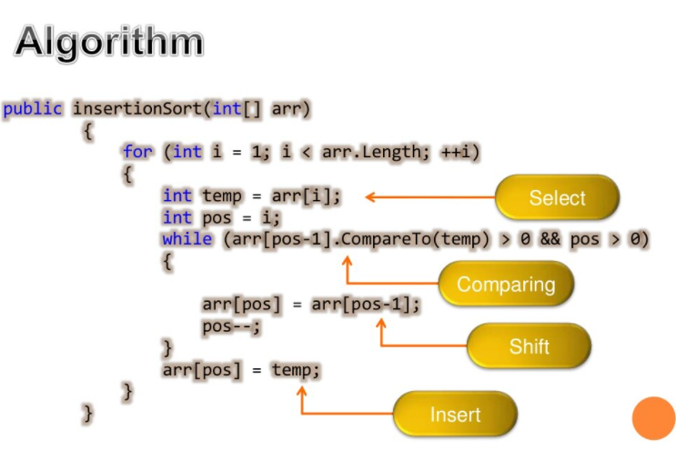

Slide 19
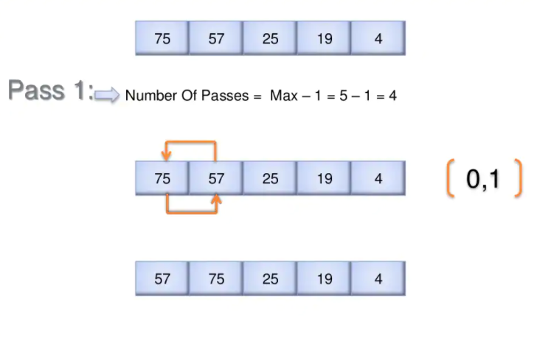

Slide 20
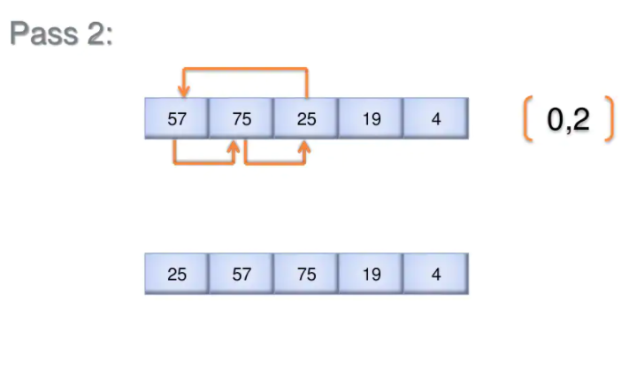

Slide 21
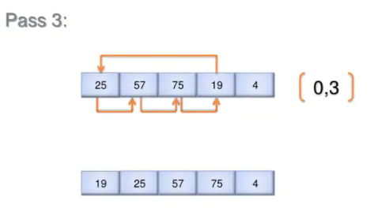

Slide 22
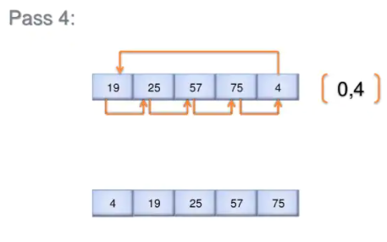

Slide 23
MERGE SORT

Slide 24
Merge Sort is a Divide and Conquer algorithm. It divides input array in two halves, calls itself for the two halves and then merges the two sorted halves. The merge() function is used for merging two halves. The merge(arr, l, m, r) is key process that assumes that arr[l..m] and arr[m+1..r] are sorted and merges the two sorted sub-arrays into one.

Slide 25
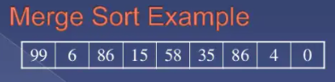

Slide 26
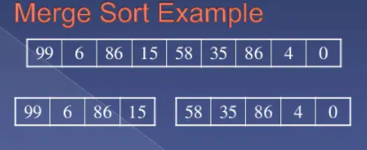

Slide 27
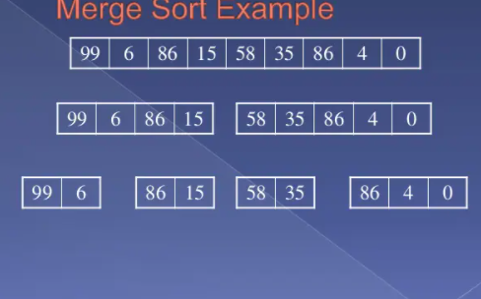

Slide 28
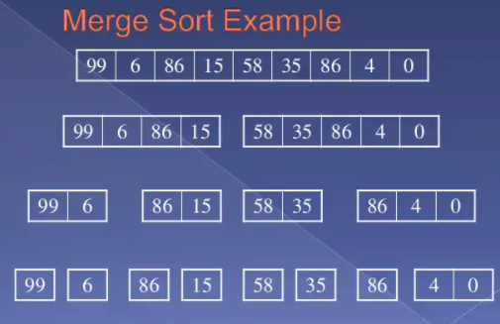

Slide 29
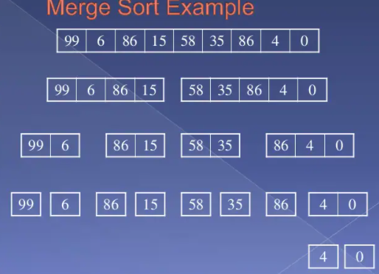

Slide 30
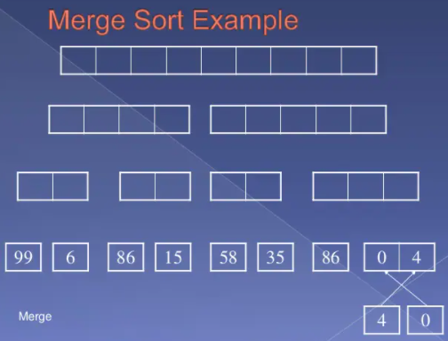

Slide 31
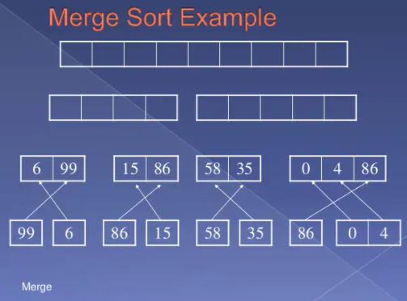

Slide 32
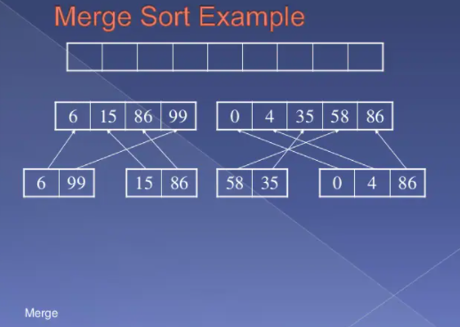

Slide 33
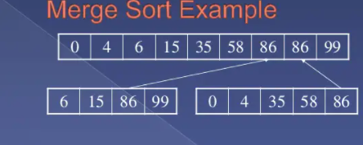

Slide 34
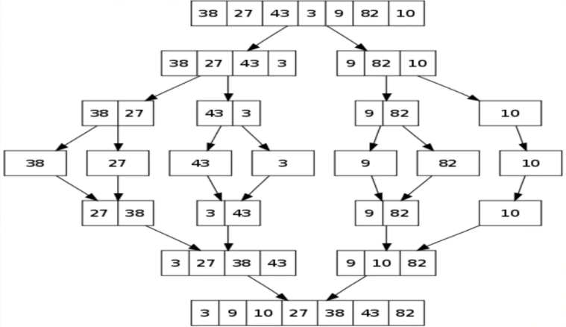

Slide 35
STACKS

Slide 36
A stack is an array or list structure of function calls and parameters used in modern computer programming and CPU architecture. Similar to a stack of plates at a buffet restaurant or cafeteria, elements in a stack are added or removed from the top of the stack, in a “last in first, first out” or LIFO order.

Slide 37
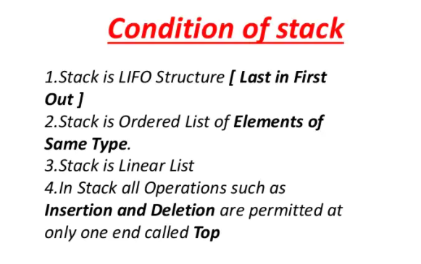

Slide 38
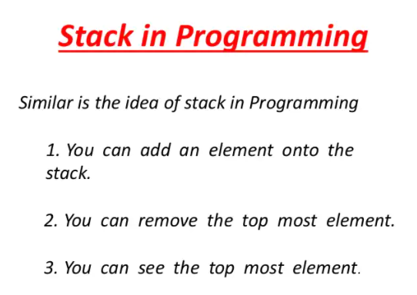

Slide 39
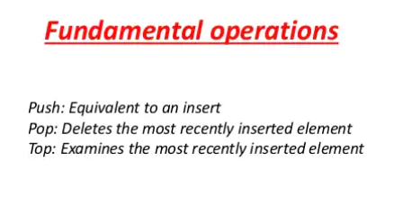

Slide 40
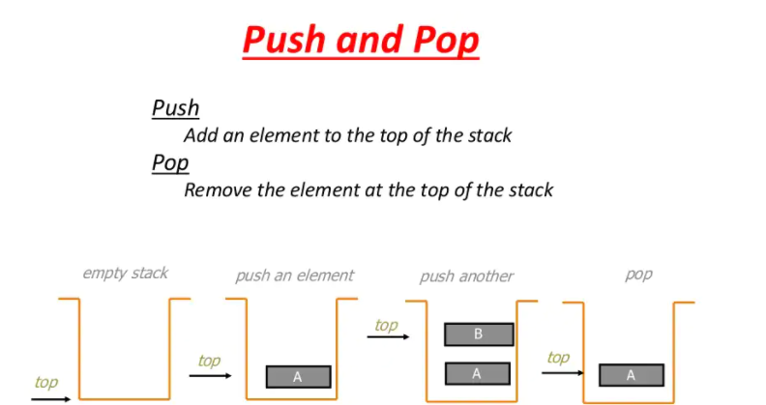

Slide 41
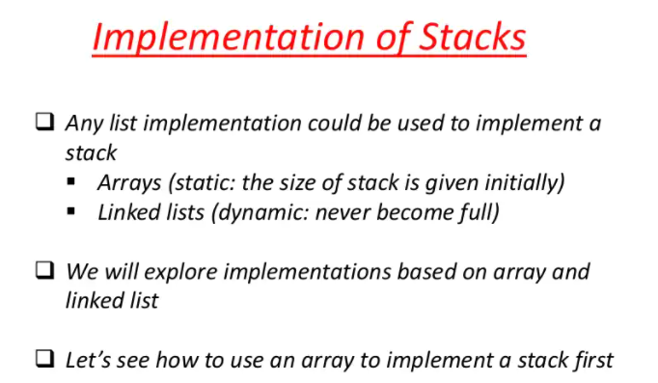

Slide 42
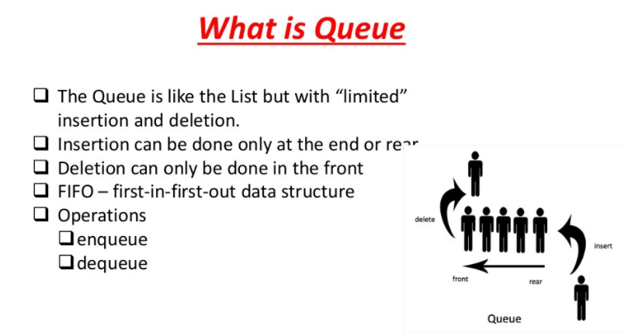

Slide 43
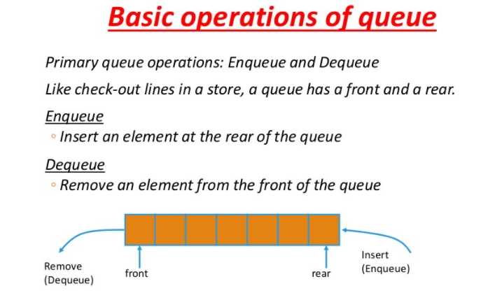

Slide 44
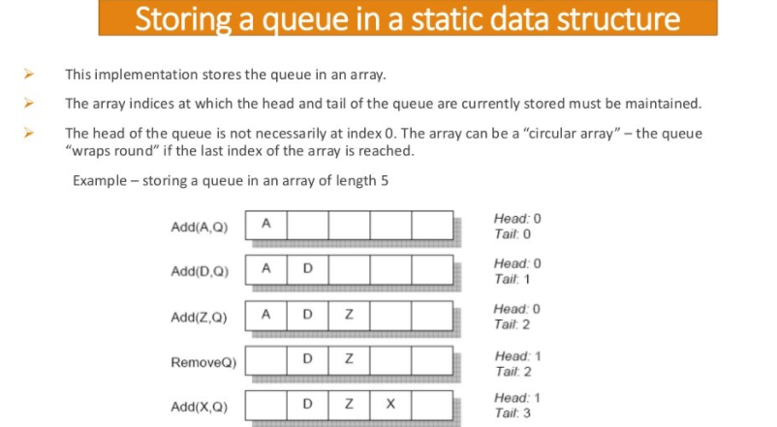

Slide 45
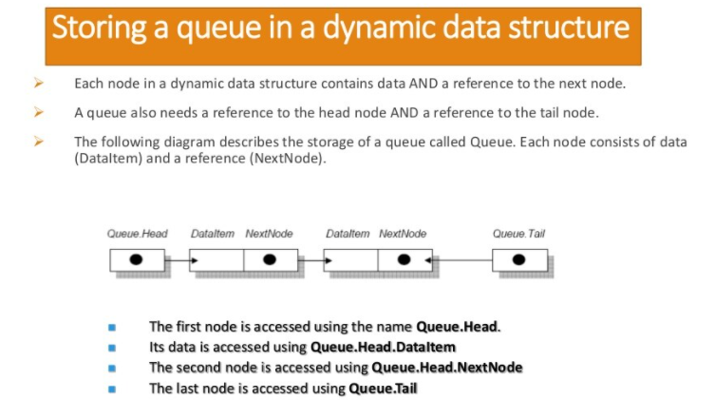

Slide 46
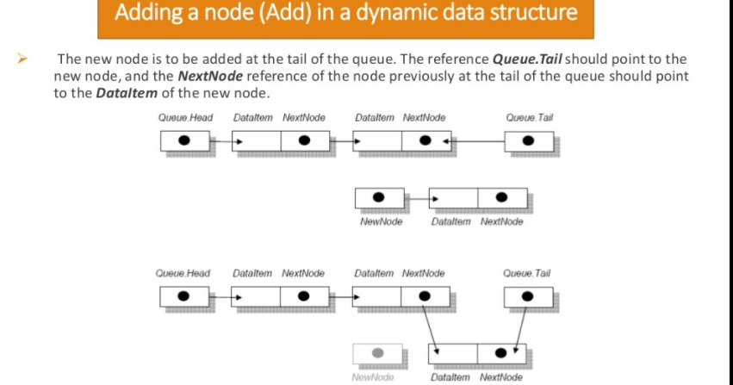

Slide 47
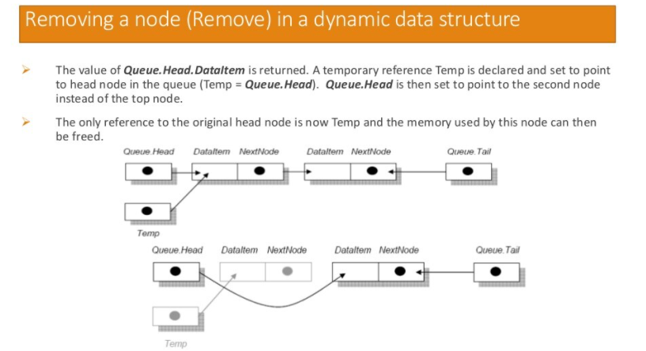

Slide 48
